Slide 1




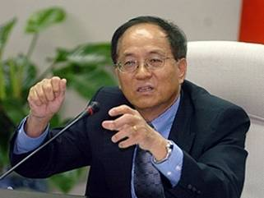
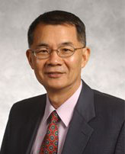


NATEA-Dallas
2008 Annual Conference presents
北美台灣工程師協會達拉斯分會2008年年會
Technology & Innovation
Taiwan's Experience
Featuring the following two
Distinguished Speakers:
Dr. Ching Shieh (謝清志博士 ), 前行政院國家科學委員會副主委
Professor Je-Chin Han (黃界清 教授 ), Distinguished Professor of Texas A&M University and ex President of NATPA
Mark your Calendar!!
Date: Saturday, November 15, 2008
Time: 2:00pm – 9:30pm
Cost: Afternoon Seminars: Free
Dinner Banquet:$25 Per Person
Place: Holiday inn Select-North Dallas
  2645 LBJ Freeway
Dallas, TX 75234
Plus:
Announcements of
Winners of 2008 College Scholarship Recipients &
2008 NATEA-Dallas Board Election Results
Contact any of the following board members
or visit www.taadfw.org/natea-dallas
Wen Chan 817.354.6215 John Hsieh 972.624.8232 Patrick Tsay 817.261.3929
Paul Chen 972.618.4102 C.Y.Chang 972.820.5705 S.Y. Chuang 817.277.9224
J.C. Chio 214.282.8811
主辦單位: 北美台灣工程師協會達拉斯分會

